Slide 1

Monitoring our Attendance
Amanda Adcock
Trust Attendance Manager

Slide 2


First Day Calling
Stated in our Trust Attendance Policy.
Made in event of a lack of contact from parents regarding their child’s absence.
Call made by a member of the school office.
DSL consulted if appropriate.

Slide 3

Third Day Calling
In the event that a pupil is absent for 3 consecutive days, a check in call is made by the FLO or office as appropriate.
Check in, not check up!

Slide 4

Attendance Monitoring
Twice termly
Arbor informed
Pupils under 93% discussed to prevent becoming a PA.
Previous attendance % added & those with a decline discussed.
Safeguarding discussed in-depth if present and appropriate.
All actions decided and outcomes shared with relevant staff-members.

Slide 5

Letters to Parents/Carers
1) Letter 1 – Sent by the school FLO to highlight attendance percentage. Followed up with a call to offer support.
2) Letter 2 – Sent by the school FLO to arrange a meeting in school. Attendance is raised as safeguarding concern in order to be discussed at school safeguarding meetings
3) Letter 3 – attendance contract to be drawn up and signed by parents
4) NTI Issued by Amanda Adcock (TAM) – notice to improve before prosecution
5) Next step – pathway 6 referral completed by Amanda Adcock.

Slide 6

Recording
All correspondence filed and recorded on my concern
Letters kept in child’s profile
All calls and communications recorded on chronology
Letter 2 - logged as a concern to ensure all DLS’s are aware
All concerns raised in relation to attendance are flagged to Amanda Adcock

Slide 7
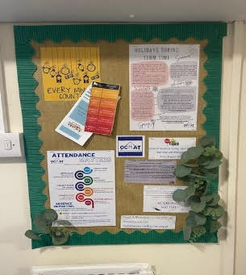
Promoting Attendance
Weekly attendance update on newsletters
Attendance notice boards in every office with up-to-date, relevant information
Weekly mention on school social media
                Assemblies in school
                Rewards and celebrations
                Presence of TAM in schools across the trust

Slide 8
Thank you

